Slide 1
Midterm Demo present
Group: I Believe I Can Fly

Slide 2
Former Ideas
Hacking
Hacking existing drone
Structures
Hardware
Communications protocols
Data transactions
Assumption:
Drone is well-established
Easy to interpret hardware
Blocking design
Pros & Cons
Pros: Less workload
Cons: Highly dependent on Drone
Self-developing
Design all parts of the drone by ourselves
Protocols
Circuits
Structures
Functionalities
Assumptions
Materials allowed
Familiar with the structure and operations of drone
Pros & Cons
Pros: More design freedom
Cons: extremely high workload

Slide 3
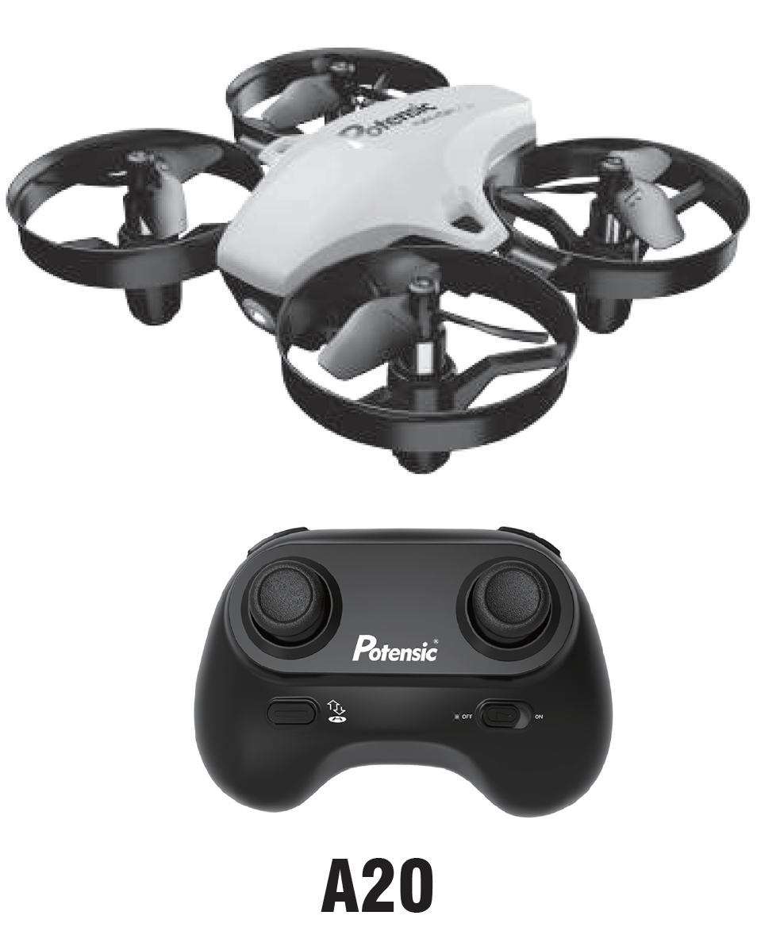
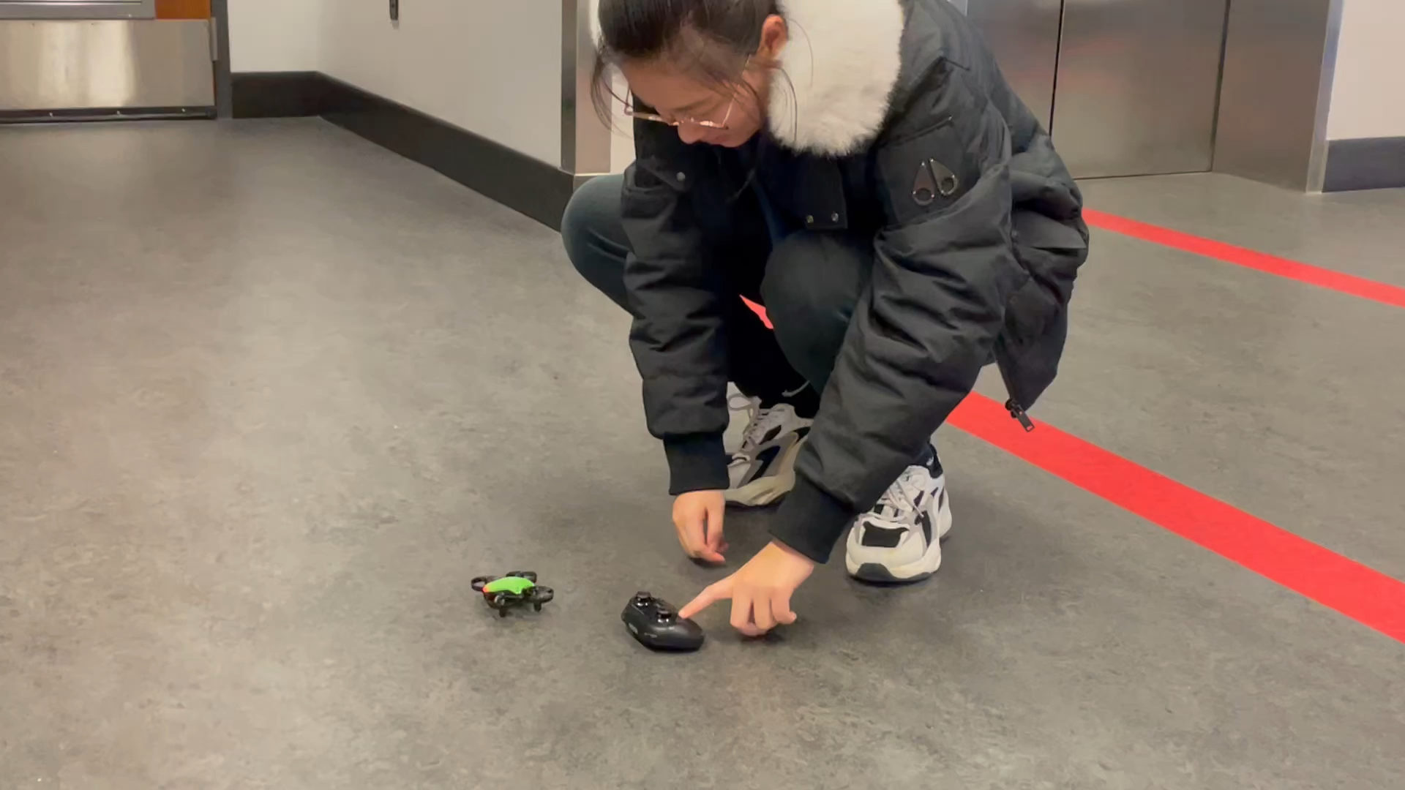
Drone Test
Facts
Time limited: Received all materials on Dec 1st (Yesterday)
Overestimated drone performance
sketchy drone PCB design

Slide 4
New Ideas
Self-designed drone with hacking
Hacking
Borrow the shell of bought drone
Hacking the structure
Hacking the signals to control the servo
Designing
Drone side RP2040 + ESP8266
Rp2040 for sending signals for servo control
ESP8266 for data transaction between PC/controller and Drone
Instruction Data will be translated to servo rotation speed and then send to RP2040
Controller side RP2040 + ESP8266 + Pico4ML
Using a self-designed balanced board with RP2040 for catching user movements
ESP8266 sends data to the drone
Pico4ML for further use

Slide 5
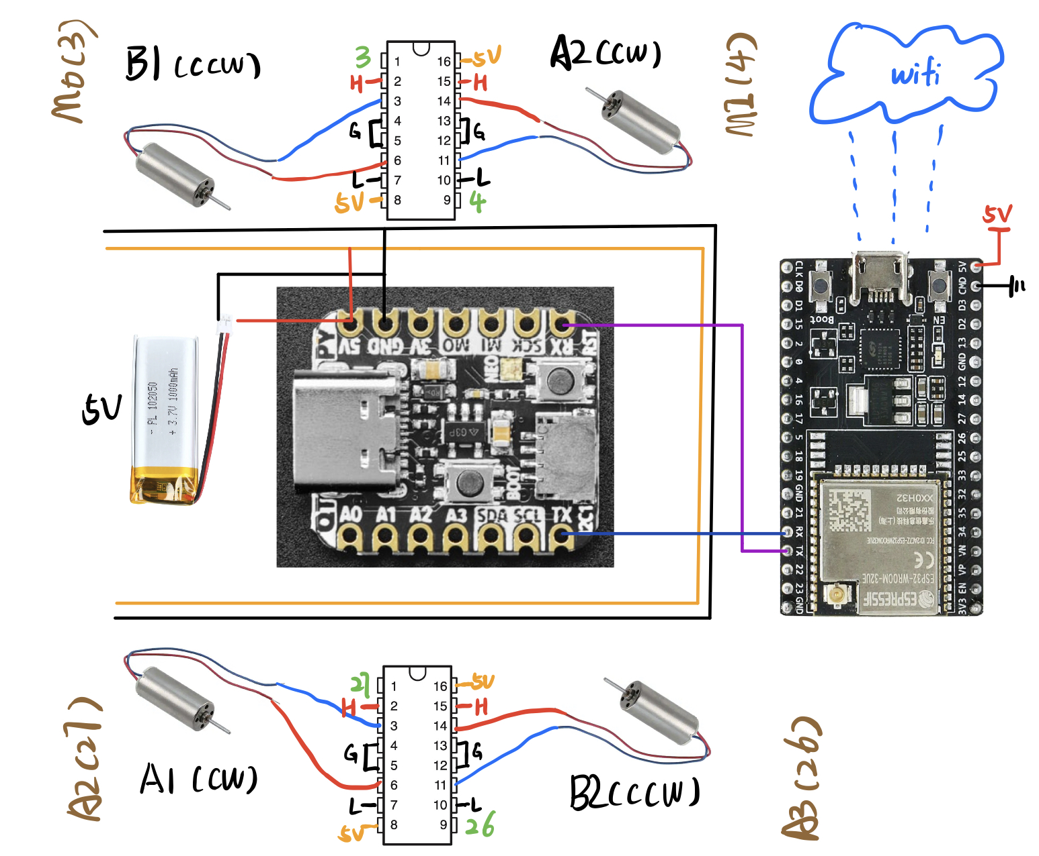
Midterm Demo
Complete the whole circuit design:
Do and combine software design
PIO in RP2040:
UART for data transactions between RP2040 and any ESP8266
I2C logical analyzer for data transaction between gyroscope and other device
PWM for servo control
Balance board part: track data from the gyroscope
Flyable
Servos lift the drone with enough and variable rotation speed

Slide 6
Questions
Materials
- Limited motor power for drones
- Limited space to place our own balanced board.
Hardware
# of pins is limited, but more components
Software
- ESP8266 communication with RP2040
- How to handle the delay of motor communication to make drone fly.

Slide 7
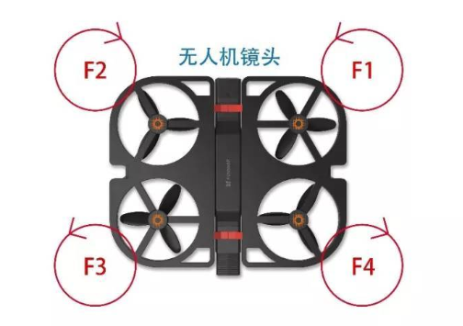
Questions
In order to avoid crazy spin of the aircraft, the four propellers of the quadcopter, the two adjacent propellers rotate in opposite directions
the counterclockwise reaction force (anti-torque) generated by F2 and F4 and the clockwise reaction force (anti-torque) generated by F1 and F3 cancel out, and the drone body can remain stable

